Slide 1


Slide 2



The Data Mentalist
My research in 5 minutes
Jacopo Lazzari, Letizia Clementi, Marco D. Santambrogio

Slide 3


Mentalism: A Kind of Magic?
If we asked someone to choose an image randomly and look at it, would we be able to know what they are watching without the help of paranormal powers?

Slide 4

Aims
To extract relevant EEG features that
allow us to predict what a person is watching

Slide 5
Aims
To achieve a deeper understanding of cognitive processes

Slide 6
State of the Art
How are EEGs studied in image categorization?
Event Related Potential - ERP
Discrete Statistical Quantities
Statistical
Analysis
Small voltages generated by the brain in response to specific stimuli.
In our case the stimuli are visual
Divide the ERP into time intervals covering its components and extract from them discrete quantities (maximum or fractional peak amplitude and latency, average amplitude, ...)
ANOVA tests represent the main approach to investigate if the features extracted from different groups/conditions are significantly diverse
S. Luck, An Introduction to the Event-Related Potential Technique, second edition, ser. A Bradford Book. MIT Press, 2014.

Slide 7
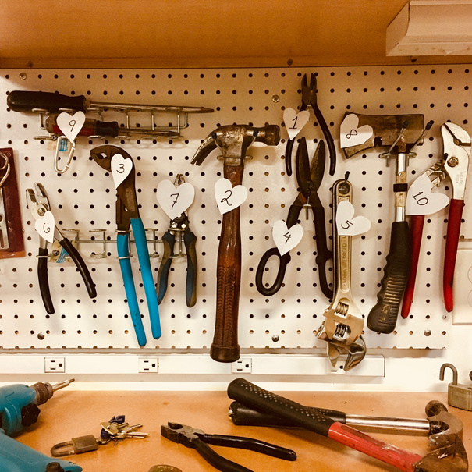




Dataset
Human electroencephalography recordings from 50 subjects
Average of Occipital channels
THINGS: A database of 1,854 object concepts
5 image categories
50 EEG reponses to a rapid serial visual presentation of images
Standard 10/10 electrode placement
Tool
Animal
Vehicle
Body Part
Food
Grootswagers, Tijl and Zhou, Ivy and Robinson, Amanda and Hebart, Martin and Carlson, Thomas (2021). Human electroencephalography recordings from 50 subjects for 22,248 images from 1,854 object concepts. OpenNeuro. [Dataset] doi: doi:10.18112/openneuro.ds003825.v1.2.0
M. N. Hebart, A. H. Dickter, A. Kidder, W. Y. Kwok, A. Corriveau, C. Van Wicklin, and C. I. Baker, “Things: A database of 1,854 object concepts and more than 26,000 naturalistic object images,” PLOS ONE, vol. 14, no. 10, pp.1–24, 10 2019

Slide 8
Every great magic trick consists of three parts or acts. The first part is called "The Pledge". The magician shows you something ordinary. [...]

Slide 9
The second act is called "The Turn". The magician takes the ordinary something and makes it do something extraordinary.
[...]

Slide 10
But you wouldn't clap yet. Because making something disappear isn't enough; you have to bring it back. That's why every magic trick has a third act, the hardest part, the part we call "The Prestige".
The Prestige, C. Nolan, 2006

Slide 11
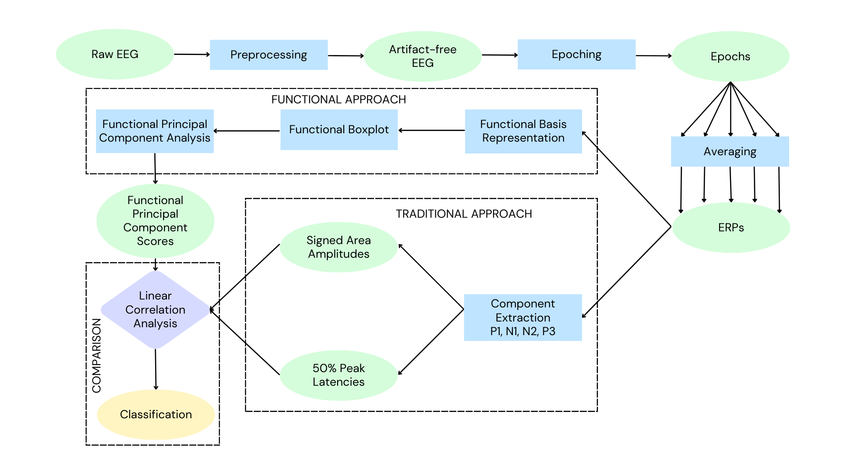
The magic trick step-by-step

Slide 12
The magic trick step-by-step

Slide 13
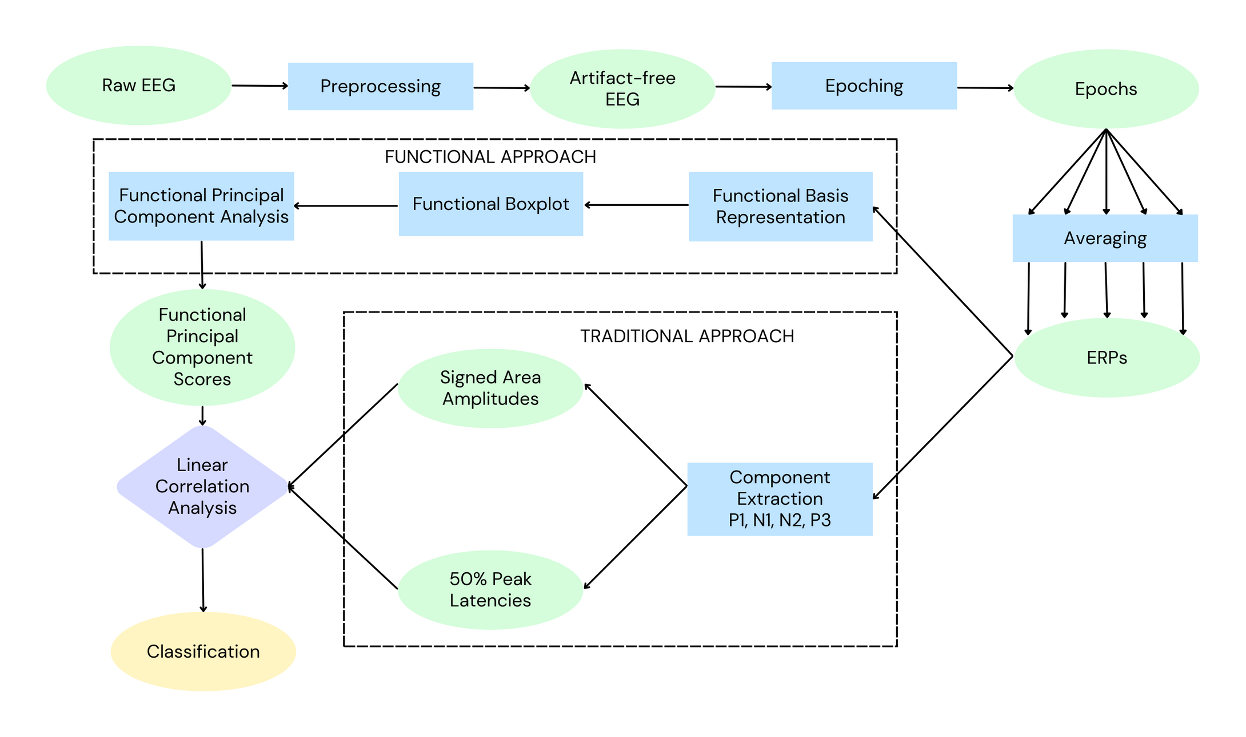
The "Pledge"

Slide 14
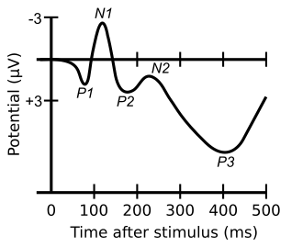
Discrete Features Extraction
We have to answer 2 questions:
Which components?
Which features?

Slide 15
Discrete Features Extraction
We have to answer 2 questions:
Which components?
Which features?
Signed Area
50% Peak Latency

Slide 16
The magic trick step-by-step

Slide 17
The "Turn"

Slide 18
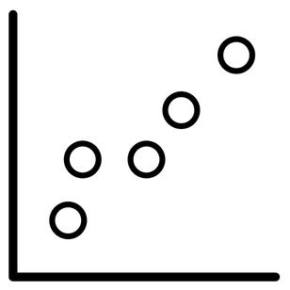
Functional Data Analysis
Functional Data Analysis grants us a family of statistical methods to analyze continuous curves rather than discrete measures
J. Ramsay, J. Ramsay, B. Silverman, S. S. Media, and H. Silverman, Functional Data Analysis, ser. Springer Series in Statistics. Springer, 2005.

Slide 19
PROS:
Evaluate ERP differences from a morphological level
Extraction of functional features
Take into account the shape of the component in its entirety
Functional Data Analysis

Slide 20
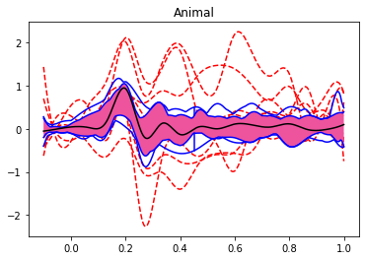
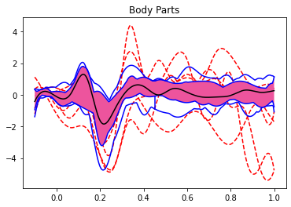
Functional Representation
We smooth the signals through a basis function representation to obtain functional objects and apply proper methods of FDA. We then implement Functional Boxplots to remove outliying ERPs

Slide 21
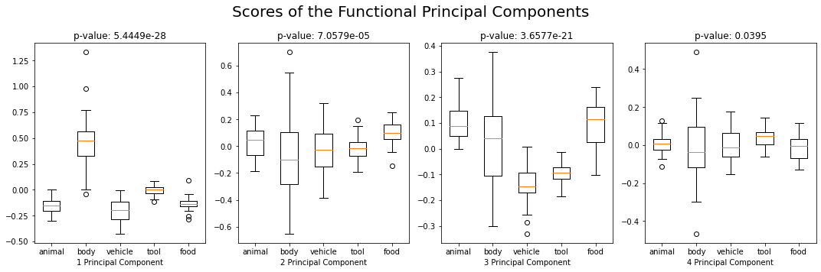
Functional Principal Component Analysis - FPCA
We extract 4 Principal Component Functions (PCF) that cumulatively explain 85% of the total variance of the data
The scores associated to each PCF vary significatively between the categories considered

Slide 22
The magic trick step-by-step

Slide 23
The magic trick step-by-step

Slide 24
Comparison
To compare the approaches, we use two methods:
Linear Correlation Analysis to investigate associations between discrete measures and PCFs' scores
Support Vector Machine classifiers to study how differently functional and discrete features perform

Slide 25


HOCUS POCUS!
And now...
Let's bring everything back for the "Prestige"

Slide 26
Results: LCA
PCFs | Area P1 | Latency P1 | Area N1 | Latency N1 | Area N2 | Latency N2 | Area P3 | Latency P3
1 | ** | * | *** | *** | *** | *
2 | ** |  |  | * |  | * | *** | *
3 | * | * | * |  |  | ** |  | **
4 | * |  | * |  |  |  | *
* -> α < 0,05/32
**-> α < e-10
**-> α < e-20

Slide 27
Results: Classification
Scores | Discrete Features | Functional Features
Accuracy | 67.57% | 83.78%
Precision | 68.83% | 84.46%
Recall | 65.01% | 81.40%
F1 | 64.40% | 82.16%

Slide 28
Conclusions
Principal Component Functions capture morphological aspects related to ERP categorization better than discrete measures
Functional Data Analysis emerges as a valid approach to solve the image classification problem
Everybody can be a mentalist, all they need is an EEG and a statistics book!

Slide 29

That's all folks!
Thank you for your attention
Jacopo Lazzari - jacopo.lazzari@mail.polimi.it
Letizia Clementi - letizia.clementi@polimi.it
Marco D. Santambrogio - marco.santambrogio@polimi.it
To know more: https://github.com/jaclaz/FDA-on-visual-ERPs

